Slide 1
UB PRIDE POINTS (Formal divider slide theme)

Slide 2
UB Pride Points (Contemporary divider slide theme)

Slide 3
An academic powerhouse
UB is both big—the largest and most comprehensive university in the State University of New York system—and bright, a flagship of SUNY and a longstanding member of the prestigious Association of American Universities.

Slide 4
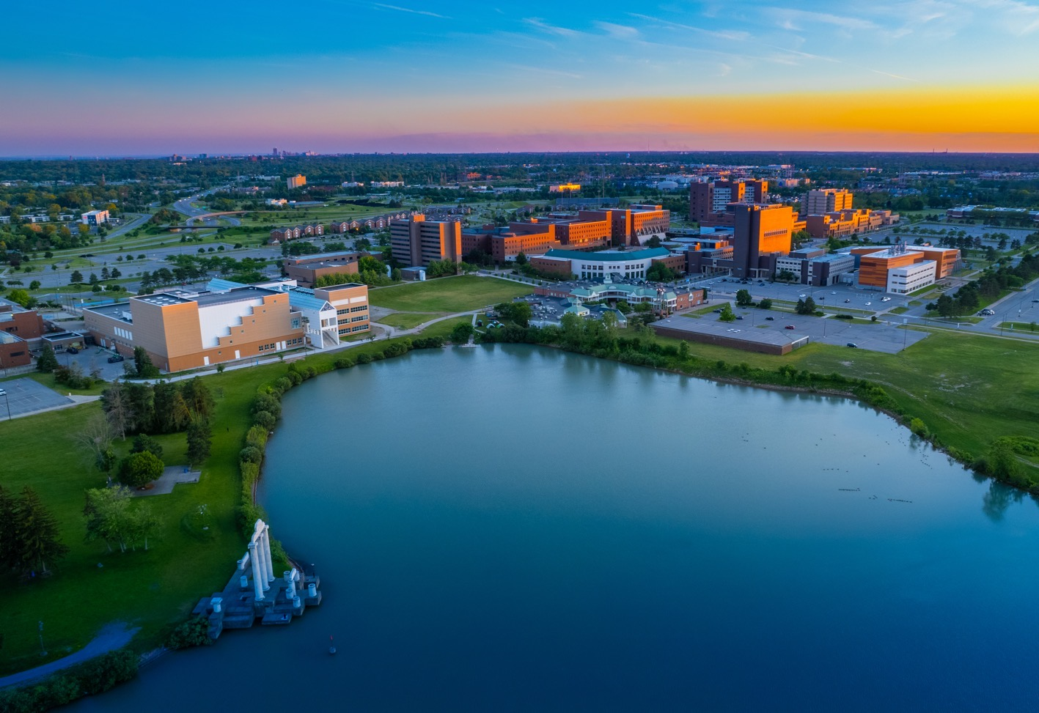
A Commanding Presence
Between UB’s three campuses—North, South and Downtown—the university encompasses nearly 1,200 combined acres and 200 buildings.

Slide 5
EXCEPTIONAL FACULTY
UB faculty have received prestigious awards and recognition, including the Nobel Prize, the MacArthur “genius grant,” the National Medal of Science, the Pulitzer Prize, the Grammy Award, and election to the National Academies and the National Inventors Hall of Fame.

Slide 6
the sky’s the limit
Every student can find their path at UB, with more than 140 undergraduate degree programs, more than 55 combined degree programs, and upward of 300 graduate, professional and certificate programs to choose from.

Slide 7
GREEN LEADERSHIP
UB is getting national recognition for its ambitious climate action plan, landing at No. 5 on the EPA’s Green Power Partnership Top 30 College & University list, and at No. 2 in the country for climate action in the Times Higher Education Impact Rankings.

Slide 8
research that matters
UB invests more than $420 million annually in research, making discoveries that lead to new cures, stronger materials, faster computers, smarter software and thousands of other improvements.

Slide 9
global reach
From the host and executive producer of NPR’s “Fresh Air” to the CEO and co-founder of China’s leading search engine, nearly 290,000 UB graduates are making a difference in every state and 150 countries around
the world.

Slide 10
local and global impact
New buildings, a stronger economy, vibrant food systems and healthier residents are all testament to UB’s impact on the community. And everything we learn here we share with the world.

Slide 11
THE FUTURE OF MEDICINE
Located in a vibrant, state-of-the-art facility in Buffalo’s medical corridor, the Jacobs School of Medicine and Biomedical Sciences is bringing superior medical education and clinical care, along with pioneering research, to the Western New York community.

Slide 12
AN ENGINE FOR GROWTH
UB’s robust entrepreneurial support system, leveraging the talents of our faculty and students along with cutting-
edge equipment, research experts, wet labs and more, is
a driving force behind Buffalo’s economic resurgence.

Slide 13
REACHING EVER HIGHER
Under the leadership of our 15th president, Satish K. Tripathi, UB is realizing an ambitious vision to become one of the top 25 public universities in the nation.

Slide 14
Internationally Renowned
With approximately 6,000 students hailing from outside our borders, UB ranks among the top 30 U.S. universities in international enrollment.

Slide 15
ascendant in athletics
UB’s 16 Division I teams play at the highest level within the NCAA, with both men’s and women’s basketball making repeat appearances in the NCAA tournament in recent years, and the football team winning back- to-back bowl games.

